Slide 1

UNIT-1

Slide 2
Machine Learning
TEXT BOOKS:
Stephen Marsland, ―Machine Learning – An Algorithmic Perspective‖, Second Edition, Chapman and Hall/CRC Machine Learning and Pattern Recognition Series, 2014.
2. Tom M Mitchell, ―Machine Learning‖, First Edition, McGraw Hill Education, 2013.
REFERENCES:
Peter Flach, ―Machine Learning: The Art and Science of Algorithms that Make Sense of Data‖, First Edition, Cambridge University Press, 2012.
Jason Bell, ―Machine learning – Hands on for Developers and Technical Professionals‖, First Edition, Wiley, 2014
3. Ethem Alpaydin, ―Introduction to Machine Learning 3e (Adaptive Computation and Machine Learning Series), Third Edition, MIT Press, 2014

Slide 3
Machine Learning
UNIT I: INTRODUCTION:
Learning(Book-1) – Types of Machine Learning – Supervised Learning – The Brain and the Neuron – Design a Learning System(Book-2) – Perspectives and Issues in Machine Learning – Concept Learning Task – Concept Learning as Search – Finding a Maximally Specific Hypothesis – Version Spaces and the Candidate Elimination Algorithm – Linear Discriminants: (Book-1) – Perceptron – Linear Separability – Linear Regression.

Slide 4
Learning
Learn from data (TB)
It gives us flexibility
Defn : A computer program is said to ‘Learn’ from experience ‘E’ wrt class of tasks ‘T and performance measure ‘P’ if the performance at tasks improves with ‘E’.

Slide 5
Examples
 | Checkers game | Handwriting recognition | Robot driving learning
T | Playing checkers | Recognizing and classifying handwritten words in images | Driving on public 4 lane highway using sensors
P | Performance measure | % of words correctly classified | Avg. distance travelled before error
E | Playing practice games | Database of handwritten words and classification | Sequence of images and steering commands

Slide 6
Machine Learning
It makes computers modify or adapt to their actions
It merges ideas from :
Neuroscience \biology\stats\maths\physics
Data mining emerged which extracts information from massive data sets
Large datasets have algorithms with high complexity
Complexity broken into two types :
Complexity of Training
Complexity of applying trained algorithm

Slide 7
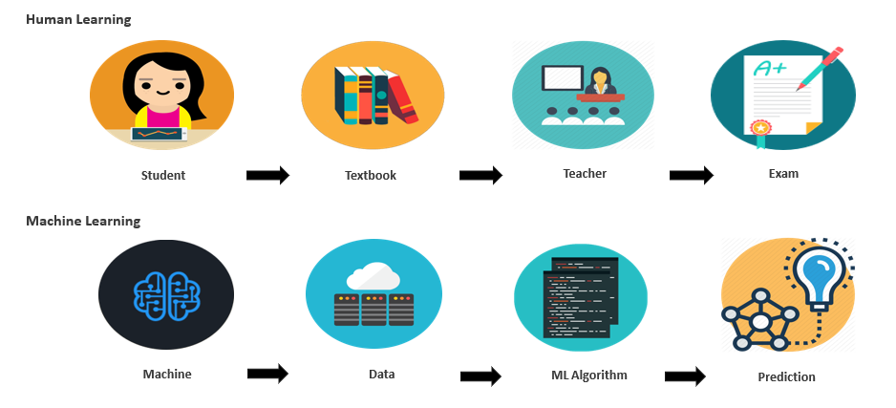

Slide 8
Applications of ML
Learning to recognize spoken words of speech recognition systems
Learning to drive autonomous vehicles which are computer controlled
Learning to construct astronomical structures
Learning to play world class games like backgammon etc..

Slide 9
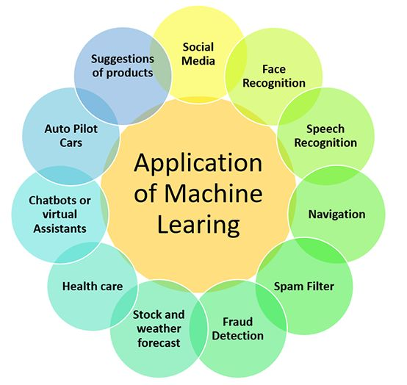
Applications of ML

Slide 10
Types of ML
1)Supervised learning : training with correct responses based on the training set. Algorithm responds to all inputs
2) Unsupervised learning : correct responses are not provided .i/p should have some thing in common. Statistical approaches are used called as density estimators .
3)Reinforcement learning : b/n supervised and unsupervised .Algorithm is told it is wrong .Different possibilities have to be tried .does not suggest improvement .
4)Evolutionary Learning : biological evolution is seen as learning process .It improves survival rate . It also suggests how good the solution is .

Slide 11
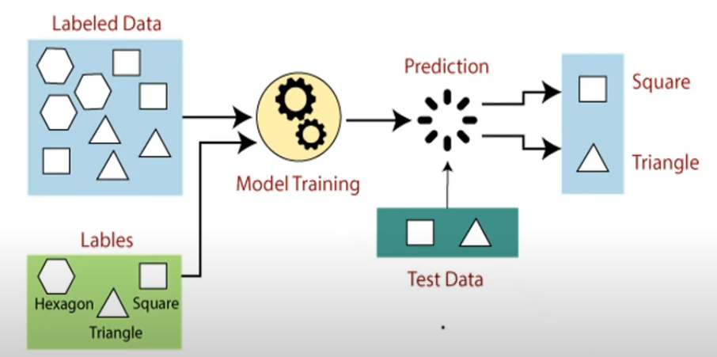
1.Supervised Learning

Slide 12
1.Supervised Learning
There are two types :a) Regression b) Classification
A set of data ( training) consists of set of input –target data
Set of data (xi, ti) , i = 1 to N
ML is used for learning process
Generalization: which solution is better to test and how we pick the values b/n data points.
a) Regression : suppose we take X ,Y,t st. X->Y, be the scalars
Training data (T_{i})
Output data (T_{i})

Slide 13
1.Supervised Learning
Regression is a statistical approach to find the correlations between variables ( dependent and independent )
Regression algorithms gives you a continuous output. That means if you are asking to build model that predict the future outcome where the output will be continuous. Then you must choose one of the regression algorithms to build model
Ex: Weather forecasting, Market Trends, etc.
Below are some popular Regression algorithms which come under supervised learning:
Linear Regression
Regression Trees
Non-Linear Regression
Bayesian Linear Regression
Polynomial Regression

Slide 14
1.Supervised Learning
Applications of Regression:
Predicting prices: For example, a regression model could be used to predict the price of a house based on its size, location, and other features.
Forecasting trends: For example, a regression model could be used to forecast the sales of a product based on historical sales data and economic indicators.
Identifying risk factors: For example, a regression model could be used to identify risk factors for heart disease based on patient data.
Making decisions: For example, a regression model could be used to recommend which investment to buy based on market data.

Slide 15
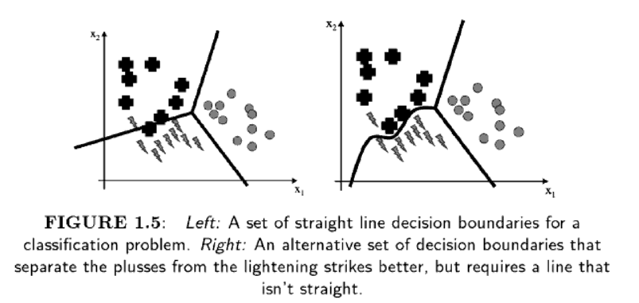
b)classification
A decision points separated by decision boundaries .
Curse of dimensionality : as no of inputs increases ,training of classifier takes longer as the no. of i/p dim grows .

Slide 16
Classification algorithms are used when the output variable is categorical, which means there are two classes such as Yes-No, Male-Female, True-false, etc.
Classification algorithms:
Random Forest
Decision Trees
Logistic Regression
Support vector Machines

Slide 17
2.Unsupervised Learning
Unsupervised learning is a machine learning technique in which models are not supervised using training dataset. Instead, models itself find the hidden patterns and insights from the given data. It can be compared to learning which takes place in the human brain while learning new things
The goal of unsupervised learning is to find the underlying structure of dataset, group that data according to similarities, and represent that dataset in a compressed format.
An unlabeled input data, which means it is not categorized and corresponding outputs are also not given.
This unlabeled input data is fed to the machine learning model in order to train it.

Slide 18
2.Unsupervised Learning
Firstly, it will interpret the raw data to find the hidden patterns from the data and then will apply suitable algorithms such as k-means clustering, Decision tree, etc.
Once it applies the suitable algorithm, the algorithm divides the data objects into groups according to the similarities and difference between the objects.

Slide 19
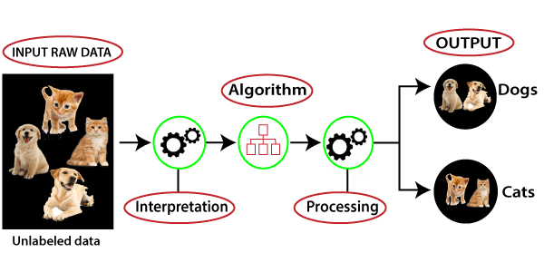
2.Unsupervised Learning

Slide 20
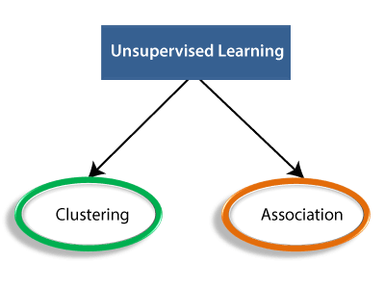
Types of Unsupervised Learning Algorithm:
Clustering: Clustering is a method of grouping the objects into clusters such that objects with most similarities remains into a group and has less or no similarities with the objects of another group. Cluster analysis finds the commonalities between the data objects and categorizes them as per the presence and absence of those commonalities.

Slide 21
Association: An association rule is an unsupervised learning method which is used for finding the relationships between variables in the large database. It determines the set of items that occurs together in the dataset. Association rule makes marketing strategy more effective. Such as people who buy X item (suppose a bread) are also tend to purchase Y (Butter/Jam) item. A typical example of Association rule is Market Basket Analysis.
Unsupervised Learning algorithms:
K-means clustering
KNN (k-nearest neighbors)
Hierarchal clustering
Anomaly detection
Neural Networks
Principle Component Analysis
Independent Component Analysis
Apriori algorithm
Singular value decomposition

Slide 22
3.Reinforcement Learning
Reinforcement Learning is a feedback-based Machine learning technique in which an agent learns to behave in an environment by performing the actions and seeing the results of actions. For each good action, the agent gets positive feedback, and for each bad action, the agent gets negative feedback or penalty.
In Reinforcement Learning, the agent learns automatically using feedbacks without any labeled data, unlike supervised learning
Since there is no labeled data, so the agent is bound to learn by its experience only

Slide 23
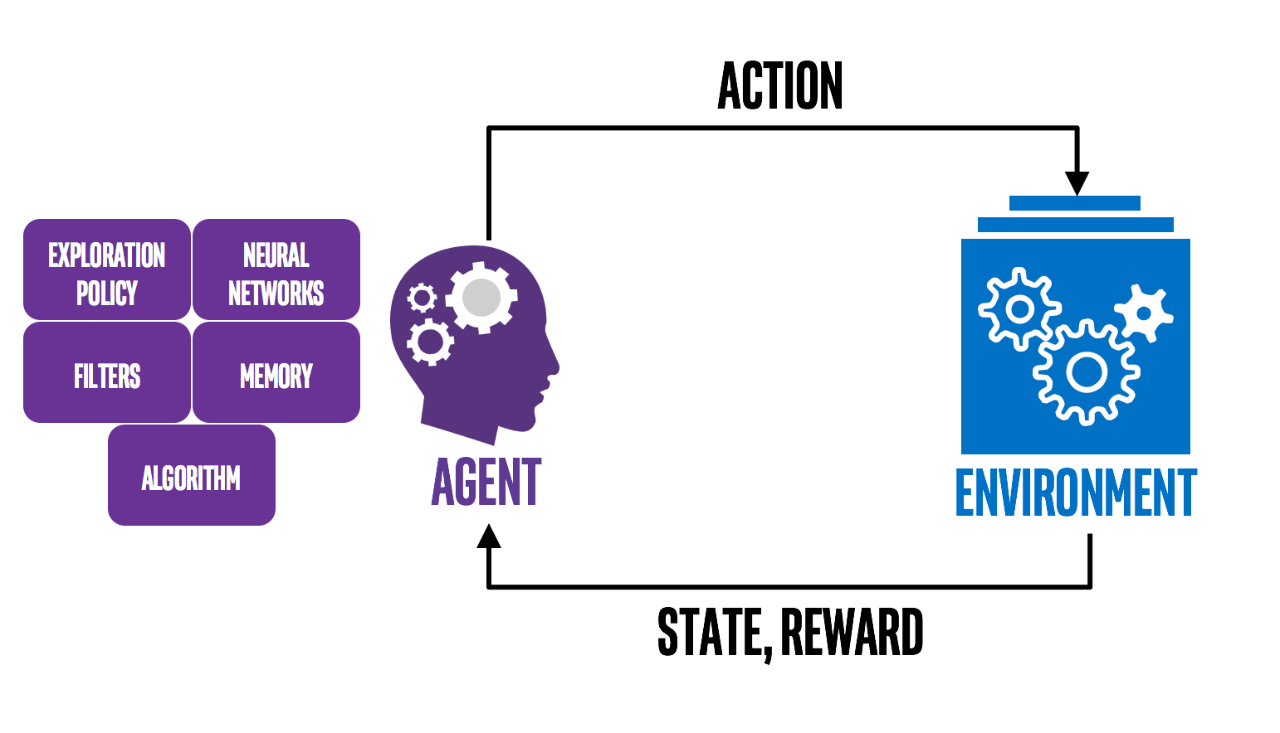
3.Reinforcement Learning
Ex: Automatic car driving , robotic dog etc..

Slide 24
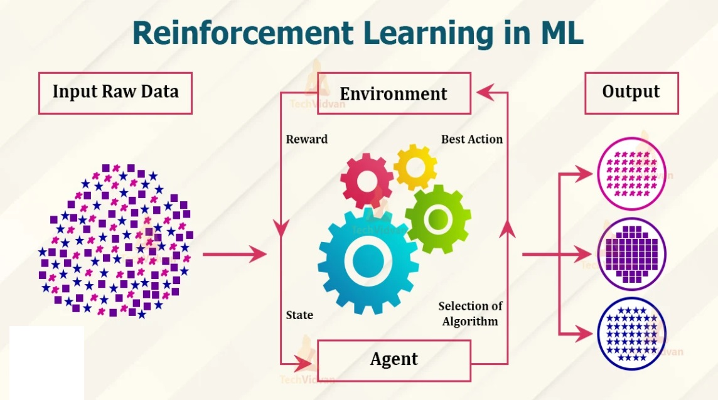
3.Reinforcement Learning

Slide 25
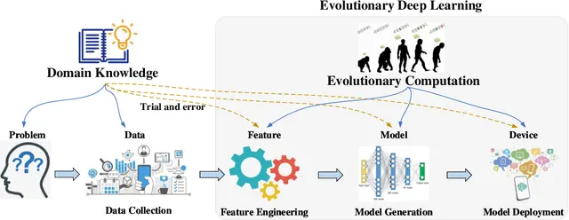
4. Evolutionary Learning

Slide 26
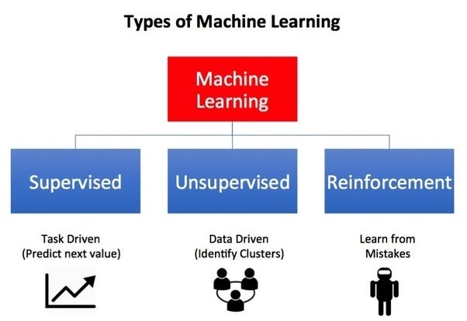

Slide 27
BRAIN AND THE NEURON
The brain deals with
What we want noise
Inconsistent data
Produces answers
Neurons : die as we grow in age without degrade in performance
Processing units of the brain are neurons (nerve cells) (100 billions = 10¹¹ )
Transmitters : contain chemicals within the fluid of the brain (↑) or (↓) in electrical potential within neuron.
If this membrane potential reaches some threshold –neuron spikes or fires.
A pulse of fixed duration is sent down the axon.
Axon : divides (arborise) into connections and connecting to each of these neurons in a synapse.
Each neuron is connected to 100 trillion (=10¹⁴) synapses
Neuron must wait for some time to recover its energy (refractory period) before it can fire again .
Learning : occurs in the brain using the principal concept as plasticity.
Plasticity : modify the strength of the synaptic connection between neurons thus creating new connection.

Slide 28
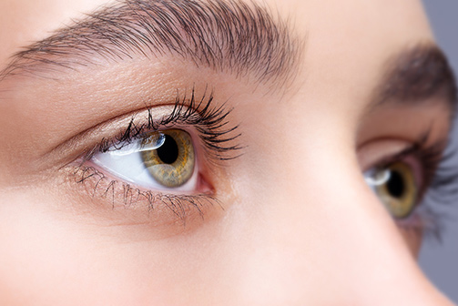

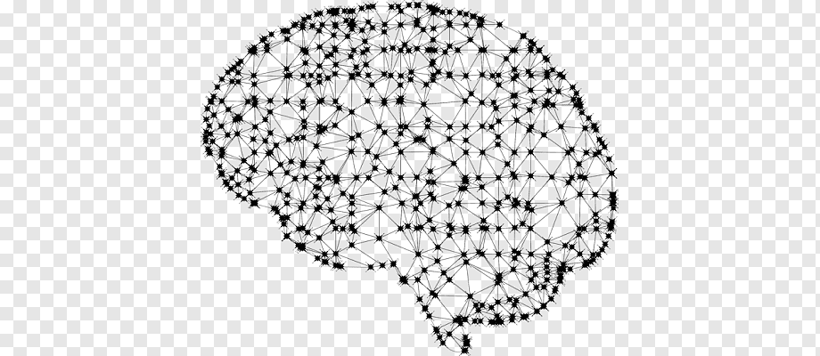
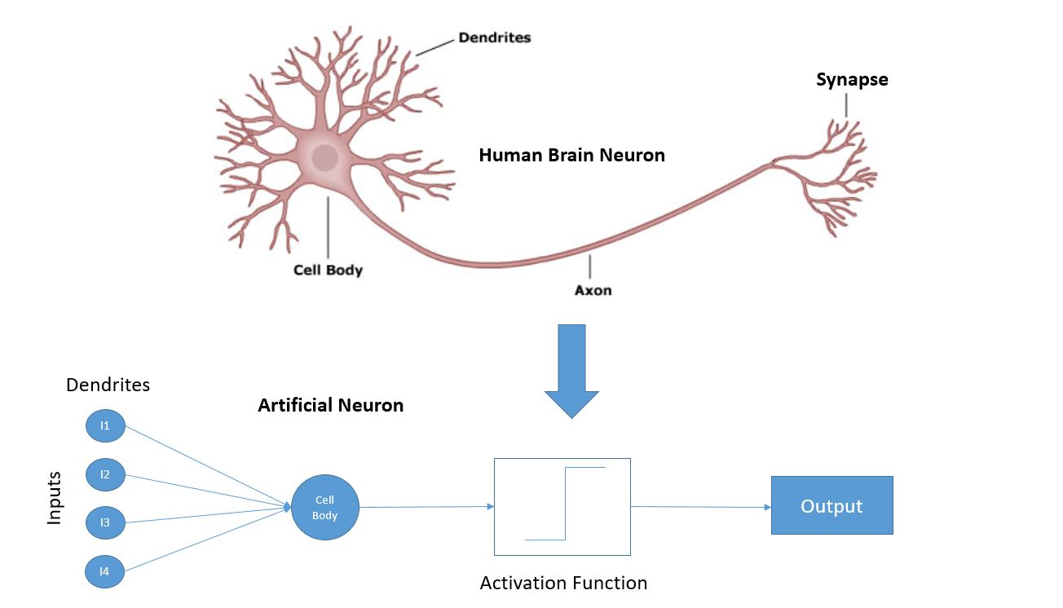
see a flower from eyes
Brain

Slide 29
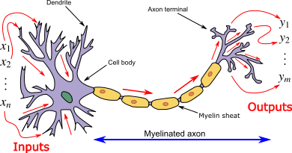
Neuron and myelinated axon, with signal flow from inputs at dendrites to outputs at axon terminals

Slide 30
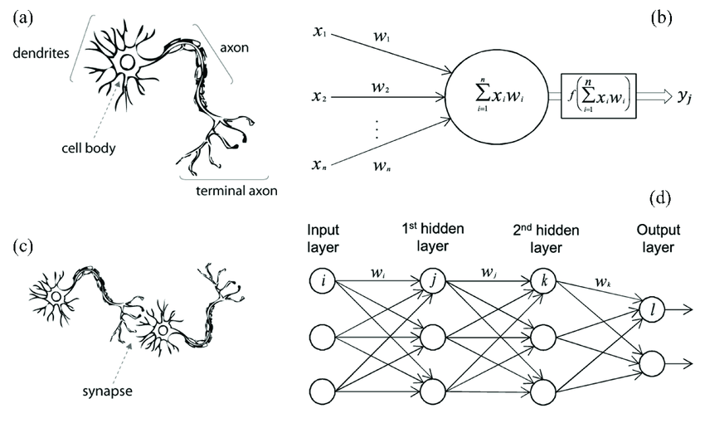

Slide 31
Methods
a)Hebb’s Rule :
Introduced by Donald Hebb
Change in the strength of the synaptic connections are ‘α’(correlation in firing of 2 connecting neurons )else the neurons will die. It is a learning rule that describes how the neuronal activities influence the connection between neurons
Hebbian Learning Rule Algorithm :
1. Set all weights to zero, wi = 0 for i=1 to n, and bias to zero.
2. For each input vector, S(input vector) : t(target output pair), repeat steps 3-5.
3. Set activations for input units with the input vector Xi = Si for i = 1 to n.
4. Set the corresponding output value to the output neuron, i.e. y = t.
5. Update weight and bias by applying Hebb rule for all i = 1 to n:

Slide 32
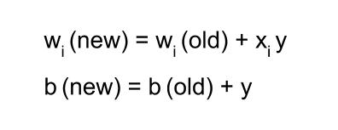
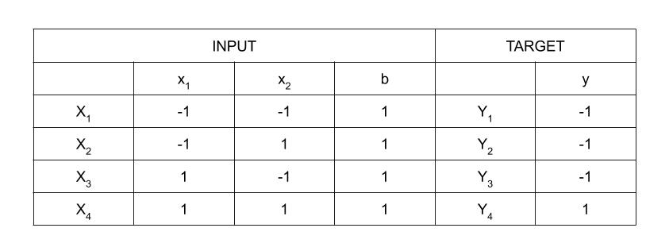
Implementing AND Gate :

Slide 33
Step 1 :
Set weight and bias to zero, w = [ 0 0 0 ]T and b = 0.
Step 2 :
Set input vector Xi = Si for i = 1 to 4.
X1 = [ -1 -1 1 ]T
X2 = [ -1 1 1 ]T
X3 = [ 1 -1 1 ]T
X4 = [ 1 1 1 ]T
Step 3 :
Output value is set to y = t.

Slide 34
Step 4 :
Modifying weights using Hebbian Rule:
First iteration –
w(new) = w(old) + x1y1 = [ 0 0 0 ]T + [ -1 -1 1 ]T . [ -1 ] = [ 1 1 -1 ]T
For the second iteration, the final weight of the first one will be used and so on.
Second iteration –
w(new) = [ 1 1 -1 ]T + [ -1 1 1 ]T . [ -1 ] = [ 2 0 -2 ]T
Third iteration –
w(new) = [ 2 0 -2]T + [ 1 -1 1 ]T . [ -1 ] = [ 1 1 -3 ]T
Fourth iteration –
w(new) = [ 1 1 -3]T + [ 1 1 1 ]T . [ 1 ] = [ 2 2 -2 ]T
So, the final weight matrix is [ 2 2 -2 ]T

Slide 35
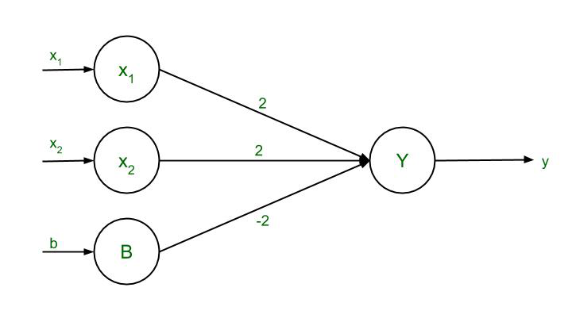
Testing the Network:
For x1 = -1, x2 = -1, b = 1, Y = (-1)(2) + (-1)(2) + (1)(-2) = -6
For x1 = -1, x2 = 1, b = 1, Y = (-1)(2) + (1)(2) + (1)(-2) = -2
For x1 = 1, x2 = -1, b = 1, Y = (1)(2) + (-1)(2) + (1)(-2) = -2
For x1 = 1, x2 = 1, b = 1, Y = (1)(2) + (1)(2) + (1)(-2) = 2
The results are all compatible with the original table.

Slide 36
b)Pavlov : “grandmother gives a chocolate to her dogs” called classical conditioning
Dogs are trained with food by ringing a bell
The strength of synapse b/n hearing bell and saliva reflex is fired.
Stimulus- something that exists in the surroundings or that is presented
Response- How the animal responds to the stimulus

Slide 37
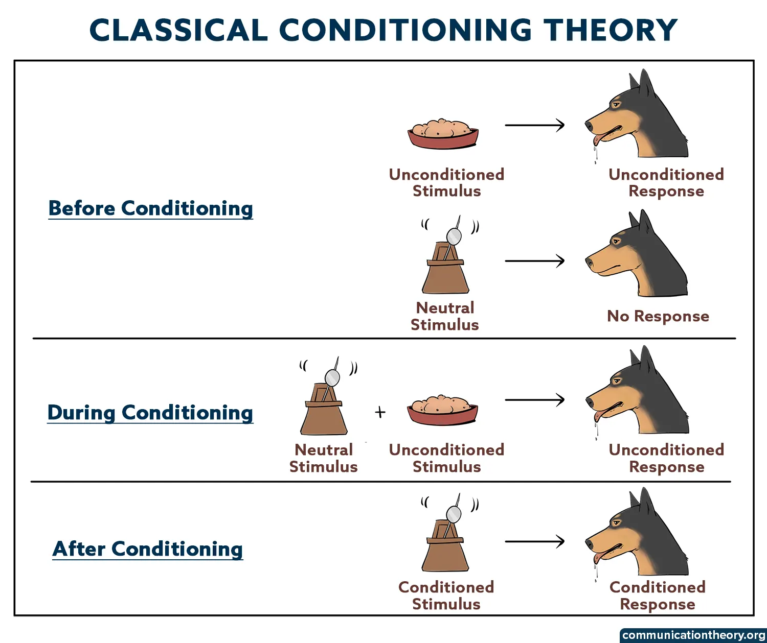
The unconditioned stimulus (US)
The Unconditioned Response (UR)
The neutral stimulus (NS)
The Conditioned Stimulus (CS)
The Conditioned Response (CR)
Ex:
When a dog presented with a meat naturally salivates to the meat, naturally salivates to the meat especially when hungry

Slide 38
c) Mc Culloch and Pits Neurons : (1943)
Mc culloch -pitts neuron was the earliest neuran n/w discovered in 1943
Also called M-P neuron
A set of weighted inputs (wi) coresp to synapse
An adder sums the i/p signals (=membrane of cell collecting electrical changes)
It has two layers i) input layer ii) output layer
since the firing of the o/p neuron is based on the threshold, the activation function here is defined as
f(yin) = 1 if yin >= θ
0 if yin < θ

Slide 39
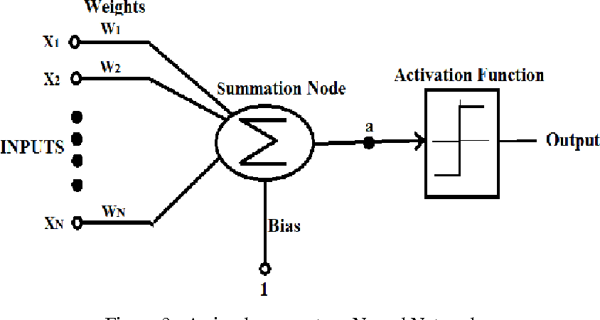
Activation Function (threshold function)
To decide whether the neurons fire (spikes) for the inputs given

Slide 40
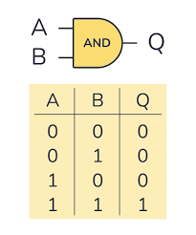
Let the inputs be (x1,x2 …. ,xm) where
if x₁ = 1(fired)
x₂ = 0(didn’t fire)
x₃ = 0.5(no biological significance)
Strength of the synapse = ( x₁w₁+x₂w₂+ … ,x_{m}w_{m})
The formula is h = Σ ( w_{i}x_{i})
The threshold value should satisfy the following condition:
θ >nw-P
n → no. of neurons in input
w → positive weight
p → negative weight
Hence , Mc culloch and pitts is a binary threshold device .

Slide 41
Yin - x₁w₁+x₂w₂+ … ,x_{m}w_{m}
(1,1) = 1*1 + 1*1 =2
(1,0) = 1*1 + 0*1 =1
(0,1) = 0*1 + 1*1 =1
(0,0) = 0*1 + 0*1 =0
Now need to find out the threshold value in such a way the y neuron should fire as per the threshold value.
Threshold value is set equal to 2 ( θ =2)
θ >= nw -p
n → no. of neurons in input (2)
w → positive weight (1)
p → negative weight (0)

Slide 42
n= 2, w =1 and p=0
Substituting the above values in the mentioned equation, we get
θ >= 2*1-0 = 2
θ >= 2
thus, the output of neuron Y can be written as
Y= f (yin) = 1 if yin >= 2
0 if yin < 2

Slide 43
Limitations of Mac Culloch and Pitts Neural Model
Neurons are more complicated
Inputs need not be linear
Neuron gives a spike train of output ( 2 outputs)
They give graded output in continuous way
Firing the changes over time
They are biochemical devices hence the amt of charge give out can vary.
Neurons are updated randomly(asynchronous).
Weights are (+ve (excitatory) & –ve (inhibitory))
Weights change from +ve to –ve
Links (synapse) are in a feedback loop but not possible in the network of loops.

Slide 44
Designing A Learning System
Choosing the training system
1.1) whether the training experience provides –direct / indirect
feedback regarding the choices made by performance of the
system
1.2) Degree to which the learner controls the sequence of training
examples
1.3) How well it represents distribution of examples
2. Choosing the target function
3. Choosing a representation for the target function
4. Choosing a Function Approximation Algorithm
4.1) Estimating training values
4.2) Adjusting the weights
5. The final design

Slide 45
Designing A Learning System
Choosing the training system:
Type of training experience available :It has impact on success or failure of the learner .
Key attributes :
i) whether the training experience provides –direct / indirect feedback regarding the choices made by performance of the system.
Eg: Checkers game : system learns from direct training (board states ,correct move sequence , final outcome )
Credit assignment : degree to which each move in the sequence deserves credit/blame for final outcome .
Learning from direct training is easier than indirect training .

Slide 46
ii) Degree to which the learner controls the sequence of training examples :
Relies on the teacher (board states and correct moves)
Learner has control over (board states and indirect training classification)
iii) How well it represents distribution of examples
P-performance must be measured (%)of win
If E: training experience consists of (games played against itself)
Distribution of training examples = testing examples
Learning Problem
Task T : playing checkers
P : % of games won in the tournament
E : games played against itself
Choice :
Exact type of knowledge to be learned
Representation for target knowledge
A learning mechanism .

Slide 47
2:Choosing Target Function
Determine exactly what type of knowledge will be learned
How it will be used by performance program?
Answer: choose best legal moves in large search space
Notation : ChooseMove : B->M
B : legal board states
M : moves
Improve the ‘P’ of Task ‘T’
Function ChooseMove

Slide 48
Evaluation Function
Assigns a numerical score to any given board state
Target Function = V
Notation V: B->R ,
where B = legal board state
R = set of real nos.
Target value V(b) for an arbitrary state b in B
If b is final board state = won ,V(b) = 100
If b is a final board state =lost ,V(b) = -100
If b= drawn state , v(b) = 0 , V(b) = drawn
If b!=final state ,V(b) = V(b’)
One must know the need to search ahead all the way to the end of the game according to (4).
The process of learning the target function is called as function approximation( ) .

Slide 49
Step:3 Choosing representation for target function
Choose a value (V) which is very close to
= linear combination of the following board features
x1: the number of black pieces on board
x2: no. of Red pieces
X3: black kings
X4: red kings
X5: no. of black pieces threatened by Red (captured on red in next turn)
X6: no. of red pieces threatened by black.
Learning Program: will represent (b) as linear function of the form :-
w₀…….w₆ = numerical coefficients /weights

Slide 50
4. Choosing a function Approximation Algorithm
To learn target function set of training examples are required .
It specifies board state b as training value
Each training example is an ordered pair
Eg : black has won the game
(x₂ = 0 , no red is left)
Target function value = +100
(black has won hence +ve)

Slide 51

4.1Estimating the training values
In Every step, We consider the successor (Depending on the next step of opponent)
= represents Approximation
successor(b) = next board state following ‘b’ (Estimating that this move will help/destroy opponent)

Slide 52

4.2 Adjusting the weights
Choosing the weights (w_{i}) to best fit training examples
Solution : best define the hypothesis /weights minimizing squared error ‘E’ between training values and values predicted over hypothesis

Slide 53
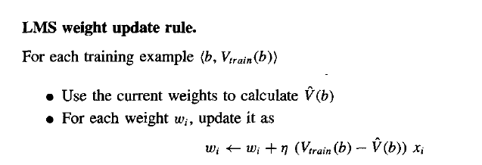
There are some algorithms to find the weights of linear functions, Here we are using Lease mean square (Used to minimize the error)
if error =0 → No need to change weights
error = positive → each weight is increased
error = negative → each weigh is decreased

Slide 54
5.THE FINAL DESIGN
It has four modules
Performance system: solves given performance task .Next move is determined by .The performance becomes increasingly accurate.
2) Critic: Takes as the input the history or trace of the game and produces as output a set of training examples of the target function .It operates on train rule ie
3)Generalizer : takes as input the training examples and produces an output hypothesis that is its estimation of target function.

Slide 55
Experiment generator: It picks new practice problems that maximize learning rate (η) of over all system

Slide 56
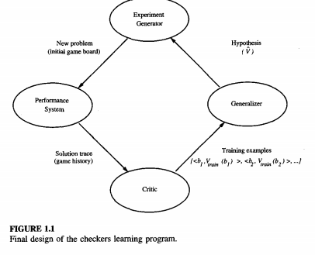

Slide 57
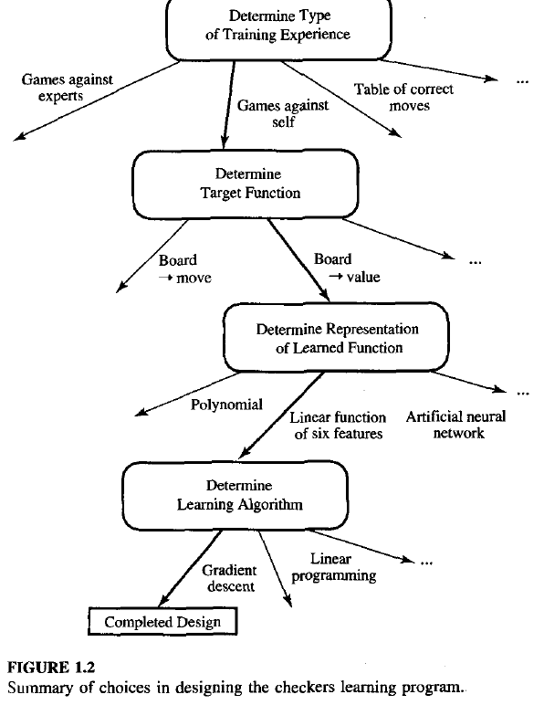

Slide 58
Issues in machine learning
What algorithm exists for learning general target function from training examples.
How much training data is sufficient?
When and how prior knowledge held by learner guide the process
What is the best strategy for choosing next training experience?
How to reduce learning task ?
How learner alter its representation in target function

Slide 59
Concept learning
Defn : Every concept is a Boolean-valued function defined over larger set.
Learning involves acquiring general concepts from specific training examples
Each such concepts can be viewed as describing some subset of objects or events defined over a larger set.
A task of acquiring potential hypothesis (solution) that best fits the given training examples

Slide 60
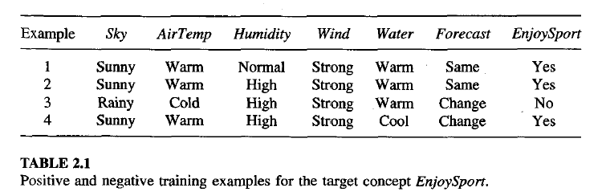
Concept learning
Days on which my friend Aldo enjoyed his favorite water sports?

Slide 61
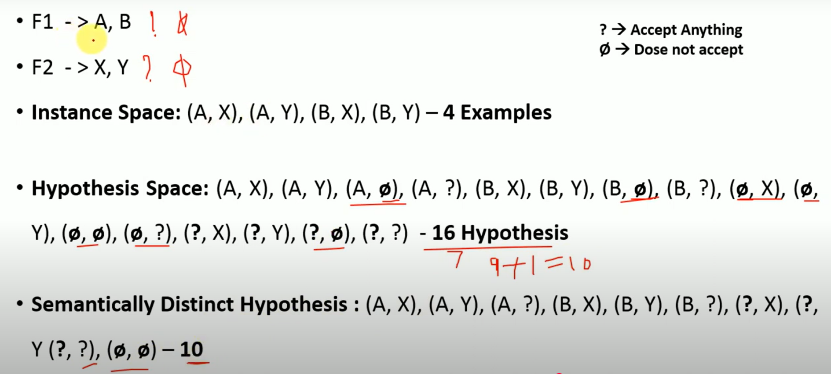

Slide 62
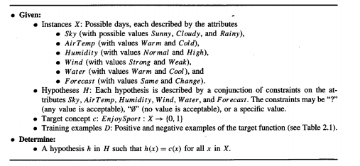

Slide 63
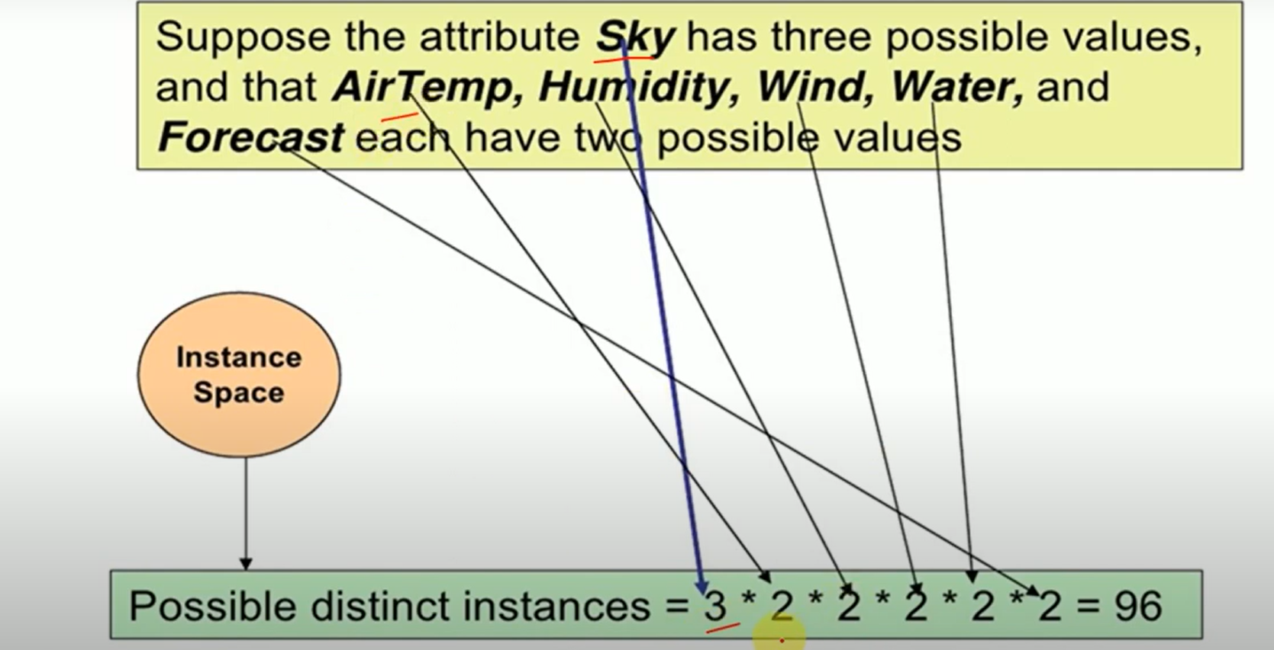
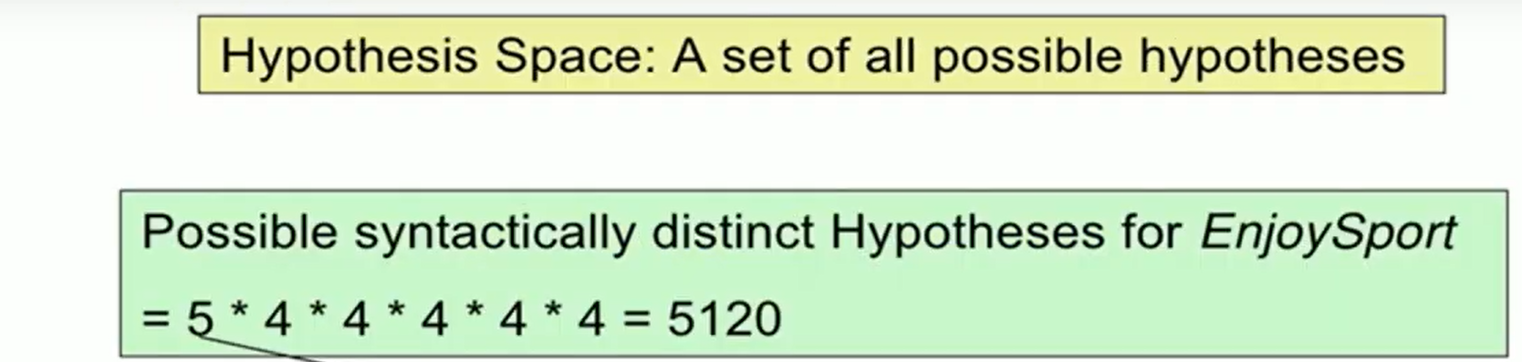

Slide 64
Hypothesis
Consists of conjunction of constraints on instance attributes
It has 6 constraints according to the table
Indicated by ‘?’ (any value is acceptable for this attribute)
Indicated by single value ‘warm’
‘Φ’ = no values accepted (null)
Defn : Inference : set of items over which the concept is defined
Let ‘x’ be the instance
Let ‘h’ be the hypothesis
‘x’ satisfies all constraints of ‘h’ ie (h(x) = 1) , x is +ve

Slide 65

Q)Aldo enjoys his favorite sport only on cold days with high humidity.
General hypothesis :
Representation of expression :
No. of days it is positive:
Instance is rep. by x = {sky,Airtemp,Humidity,Wind,water,forecast}
Target Concept(c)= concept /function to be learned .C is a Boolean valued function over x

Slide 66
Target Concept corresponds to the value of the attribute.
Ordered pair (x, c(x)) describes training example

Slide 67
Given : target concept ( c )EnjoySport :X {0,1}
D = set of available training examples
H = set of all possible hypothesis regarding the identity of target concept .
X= possible days described by the attributes
Determine : ‘h’ in ‘H’ that represents Boolean-valued functions defined over X
h =
Goal : find ‘h’ such that h(x) = c(x) for all x in X

Slide 68
Inductive Learning Hypothesis
It can guarantee that the output hypothesis fits the target concept over the training data
Hypothesis that best fits the observed training data
Defn : any hypothesis found to approximate target function over large set of training examples .

Slide 69
Concept learning as a search
Defn : searching through large space of hypothesis implicitly defined by hypothesis representation
Goal : find the hypothesis that best fits the training examples .
Instance space X : contains 3.2.2.2.2.2 = 96 distinct instances
Hypothesis (H) : contains 5.4.4.4.4.4=5120 (syntactically distinct hypothesis )
If one of the move ‘Φ’ is present in the (semantically) distinct hypothesis then 1+(4.3.3.3.3.3) = 973(if it considers every instance as negative )

Slide 70

General to specific ordering of hypothesis
Defn : we can design learning algorithm that exhaustively searches even infinite hypothesis space without explicitly enumerating every hypothesis .
Consider 2 hypothesis
Consider h1 and h2 are +ve(h2 imposes fewer instances and classifies more instances as +ve

Slide 71
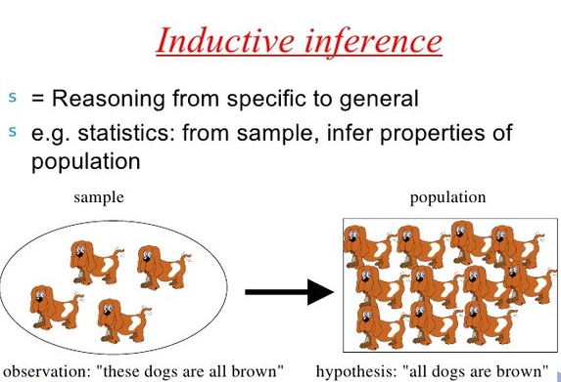

Slide 72
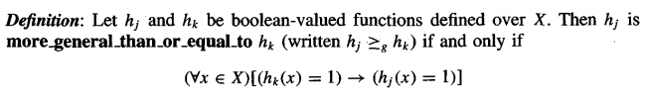




For any instance : x in X
Hypothesis: h in H
X satisfies h iff: h(x) = 1
Special case : one hypothesis is more general than others
h_{j} ( more general _ than) h_{k} ^{indicated} as iff
Defines partial order over hypothesis space H if it is (reflexivity(
) , anti-symmetric (if (a,b)€ R and (b,a) € R then a = b ) and transitivity

Slide 73
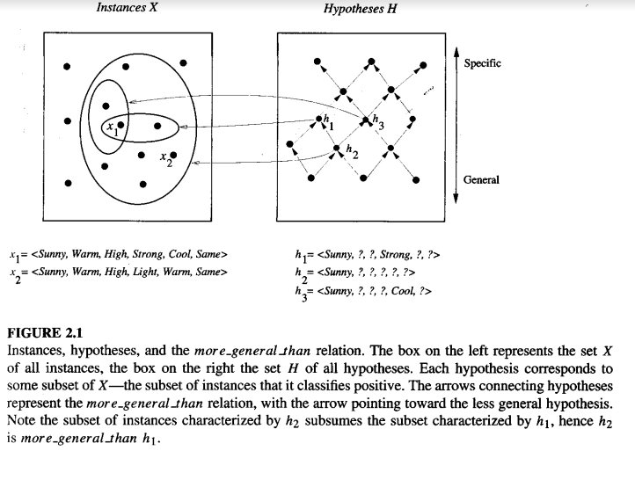

Slide 74

Finding Maximally Specific Hypothesis [FIND-S]
Hypothesis consists of training examples (+ve and –ve)

Slide 75
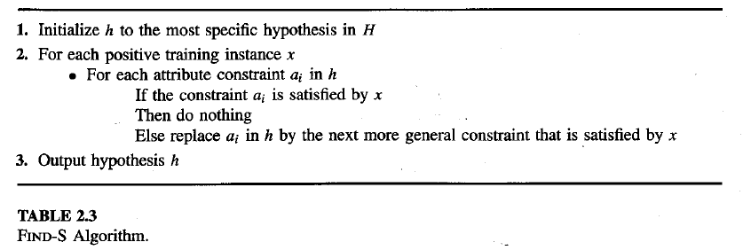

Slide 76
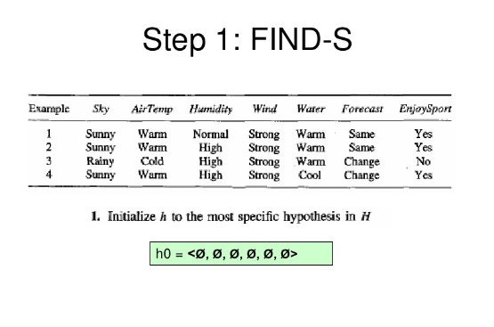

Step 1
Initialize h to more specific hypothesis in H
None of the ‘Φ’ constraints are satisfied
according to the example
h is specific(–ve)
Place’?’ to any
position (3rd ).
This is –ve(no
revision is
required for h

Slide 77
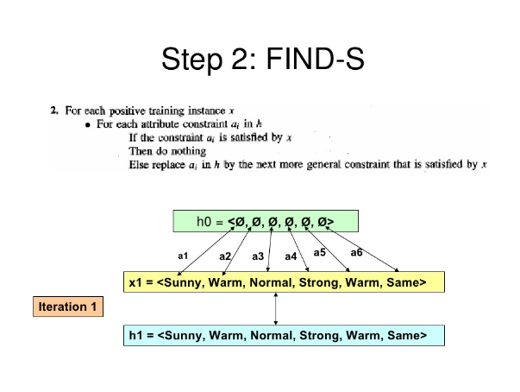

Slide 78
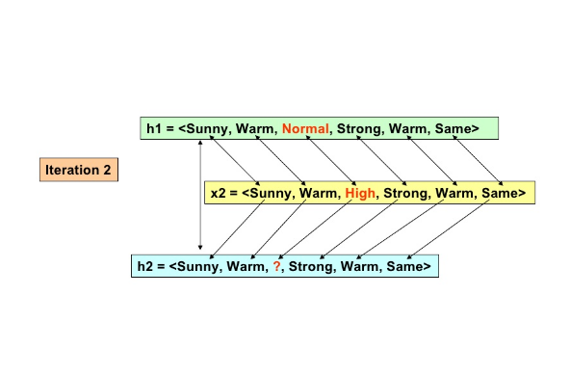
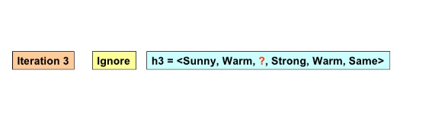

Slide 79
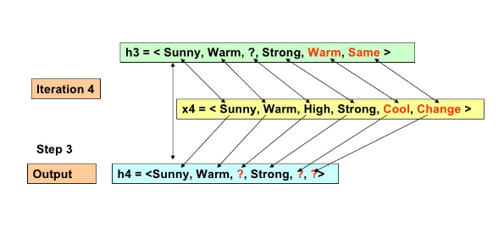
4th training is a positive example
Search moves from h to h from most specific to most general hypothesis along partial ordering

Slide 80
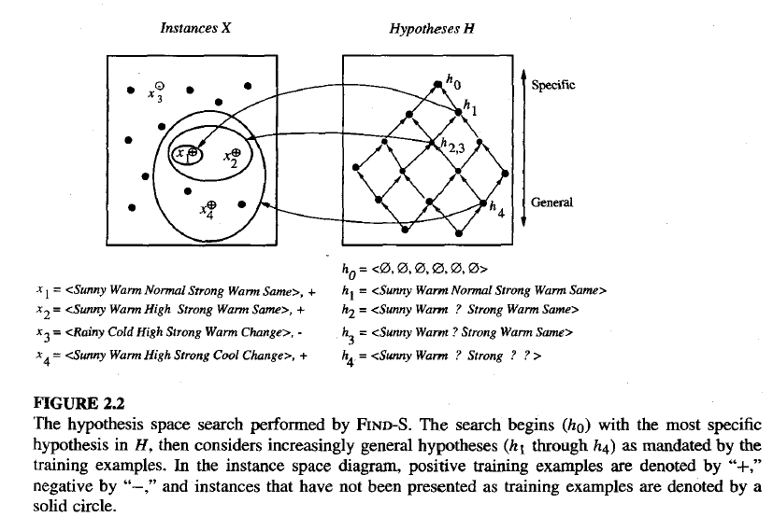

Slide 81
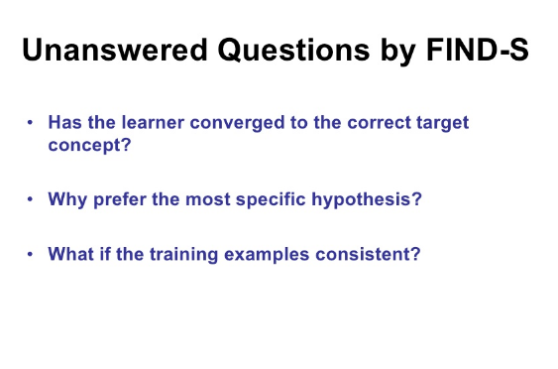

Slide 82
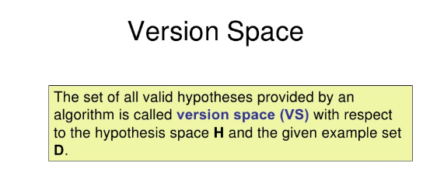
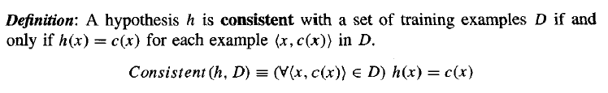
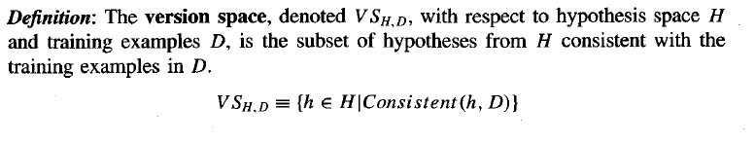
No explicit enumerated members
IT uses more _general_then partial ordering to main representation of set of H .
The subset of all hypothesis is called as version space with respect to H and D.

Slide 83

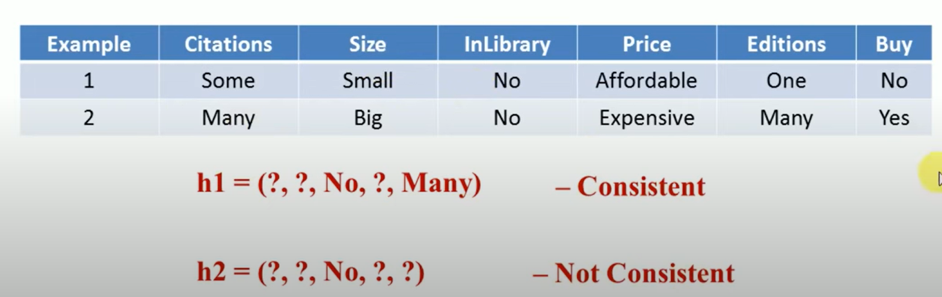

Slide 84
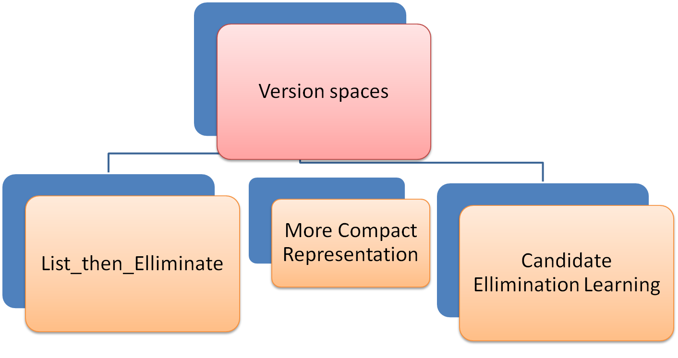
Version spaces types

Slide 85
1.List _Then _eliminate
List all of its members
1st initialize version space containing all H
Eliminate any H focused inconsistent
Version space shrinks as training examples are observed
Only one H remains that is consistent with all examples giving Target Concept( c )
If insufficient data = FOUND then output entire set of H consistent with observed data
It can be applied when H is finite
It output all H

Slide 86
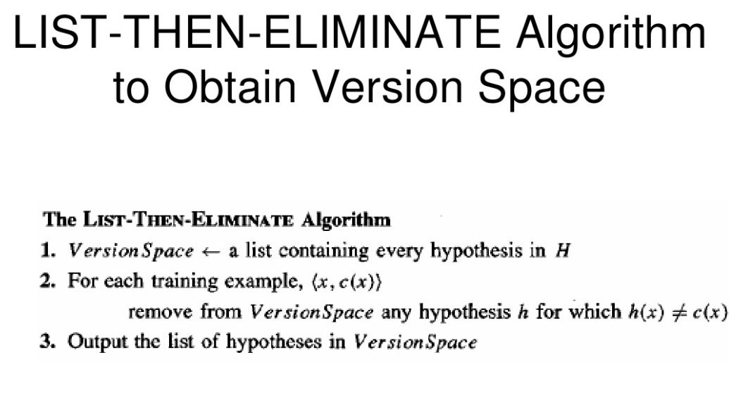

Slide 87
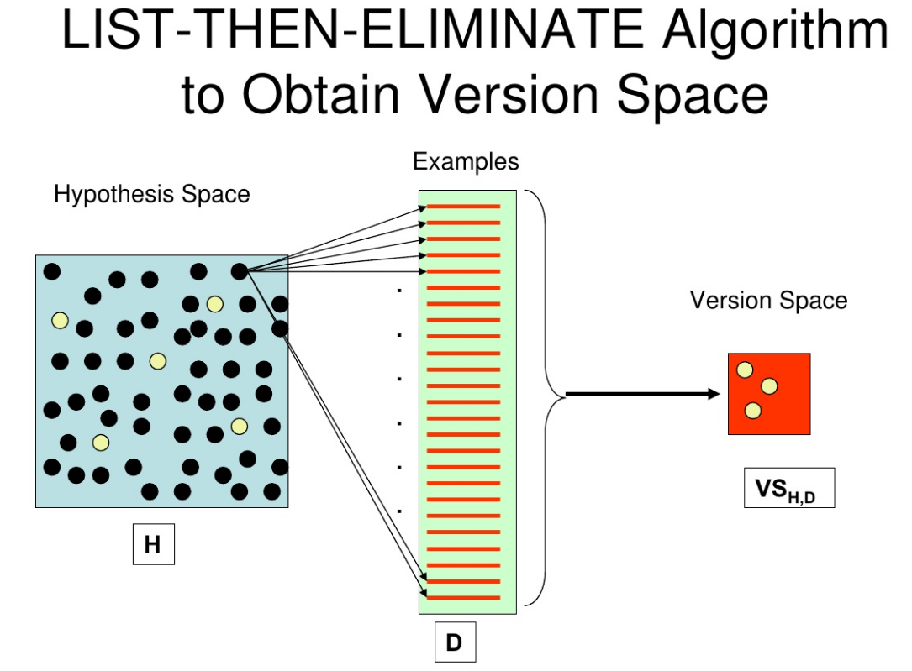

Slide 88
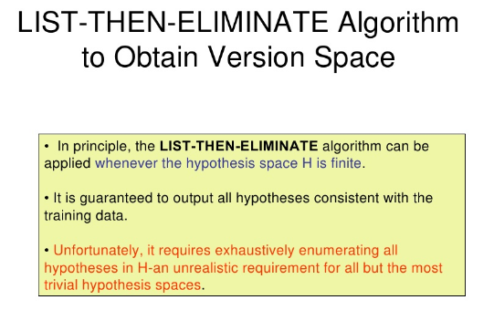

Slide 89
Example:

Slide 90
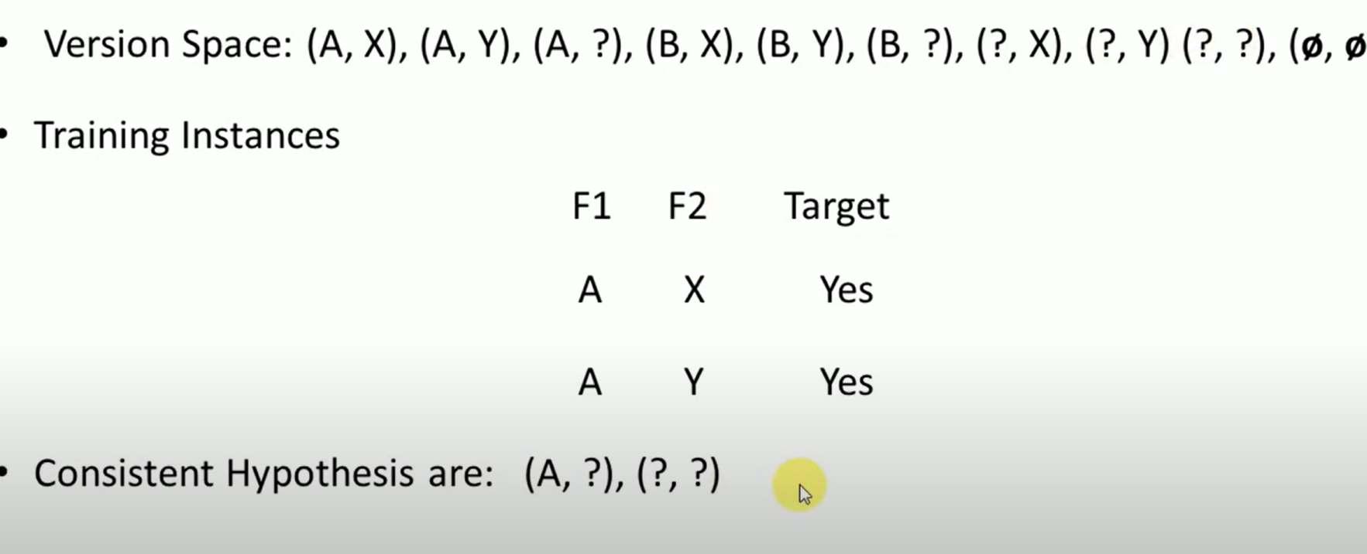

Slide 91
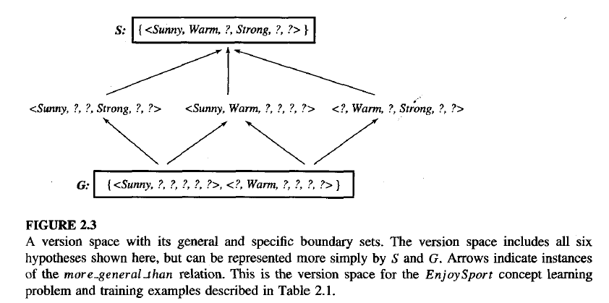
2.More compact Representation
Represented by most general and least general members
They form general and specific boundary sets with partially ordered hypothesis space.

Slide 92

Boundary sets G and S

Slide 93
Version space representation theorem
Let X be any arbitrary set of instances
Let H be set of Boolean values hypothesis defined over X
Let c:X->[0,1] be arbitrary target defined over X
Let D be an arbitrary set of training examples {<x, c(x)>} for all values of X,H,c,D such that S and G are well defined .

Slide 94


Slide 95


Slide 96


Slide 97


Slide 98


Slide 99


Slide 100


Slide 101


Slide 102


Slide 103


Slide 104


Slide 105


Slide 106


Slide 107


Slide 108

Perceptron
Type of ANN is called as perceptron, is the first neural network model designed in 1958
Perceptron is linear binary classifier used for supervised learning
Perceptron learning model is a combination of McCulloch-pitts model and Hebbian learning rule of adjusting weights

Slide 109

It takes a value of real valued inputs and calculates a linear combination of these inputs .
Given <x1,x2, ….. , xn> as inputs and a (x1,x2,…. , xn) is computed by perceptron
W_{i} = real valued constant
-w₀ is a threshold on weighted combinations of inputs .
It gets the outputs as 1

Slide 110



If then
vector form is
Perceptron function is
The space H of the candidate hypothesis considered in perceptron learning = set of ( all possible real valued weight vectors)

Slide 111

Linearly separable
+ve and –ve examples are separated by a hyperplane and it is called as linearly separable .
If we assume boolean values of 1(true) and 0 ( false )
Perceptron can be represented as
Cannot be represented as its value is 1

Slide 112


Slide 113

Perceptron

Slide 114


Slide 115


Slide 116

complexity is O(mn).
For T iterations, costs is O(Tmn).

Slide 117
example
w0 = −0.05, w1 = −0.02, w2 = 0.02.
inputs are 0: (0, 0)
Input to the bias weight is always −1,\
value that reaches the neuron is −0.05 × −1 +−0.02 × 0 + 0.02 × 0 = 0.05
Result : This value is above 0, so the neuron fires and the output is 1, which is incorrect according to the target.
Apply the equation : wij ← wij − η(yj − tj ) · xi for η = 0.25
w0 : −0.05 − 0.25 × (1 − 0) × −1 = 0.2, (3.7)
w1 : −0.02 − 0.25 × (1 − 0) × 0 = −0.02, (3.8)
w2 : 0.02 − 0.25 × (1 − 0) × 0 = 0.02. (3.9)
feed in the next input (0, 1)
apply the learning rule again:
w0 : 0.2 − 0.25 × (0 − 1) × −1 = −0.05, (3.10)
w1 : −0.02 − 0.25 × (0 − 1) × 0 = −0.02, (3.11)
w2 : 0.02 − 0.25 × (0 − 1) × 1 = 0.27. (3.12)
(1, 0) input the answer is already correct
.

Slide 118


Slide 119
Linear Regression
Linear regression is a basic and commonly used type of predictive analysis.
The overall idea of regression is to examine two things:
(1) does a set of predictor variables do a good job in
predicting an outcome (dependent) variable?
(2) Which variables in particular are significant predictors of the outcome variable, and in what way do they– indicated by the magnitude and sign of the beta estimates– impact the outcome variable?

Slide 120
These regression estimates are used to explain the relationship between one dependent variable and one or more independent variables.
The simplest form of the regression equation with one dependent and one independent variable is defined by the formula
y = c + b*x
where y = estimated dependent variable score,
c = constant,
b = regression coefficient,
x = score on the independent variable.

Slide 121
Naming the Variables. There are many names for a regression’s dependent variable. It may be called an outcome variable, criterion variable, endogenous variable, or regressand.
The independent variables can be called exogenous variables, predictor variables, or regressors.
Three major uses for regression analysis are
determining the strength of predictors,
forecasting an effect, and
(3) trend forecasting.

Slide 122
First, the regression might be used to identify the strength of the effect that the independent variable(s) have on a dependent variable. Typical questions are what is the strength of relationship between dose and effect, sales and marketing spending, or age and income.
Second, it can be used to forecast effects or impact of changes. That is, the regression analysis helps us to understand how much the dependent variable changes with a change in one or more independent variables.
A typical question is, “how much additional sales income do I get for each additional $1000 spent on marketing?”
Third, regression analysis predicts trends and future values. The regression analysis can be used to get point estimates. A typical question is, “what will the price of gold be in 6 months?”

Slide 123

Linear Regression

Slide 124



Slide 125

Linear Regression

Slide 126


